Slide 1
CREATING SERVER FOR BACKEND
SALMAN AHMED G

Slide 2
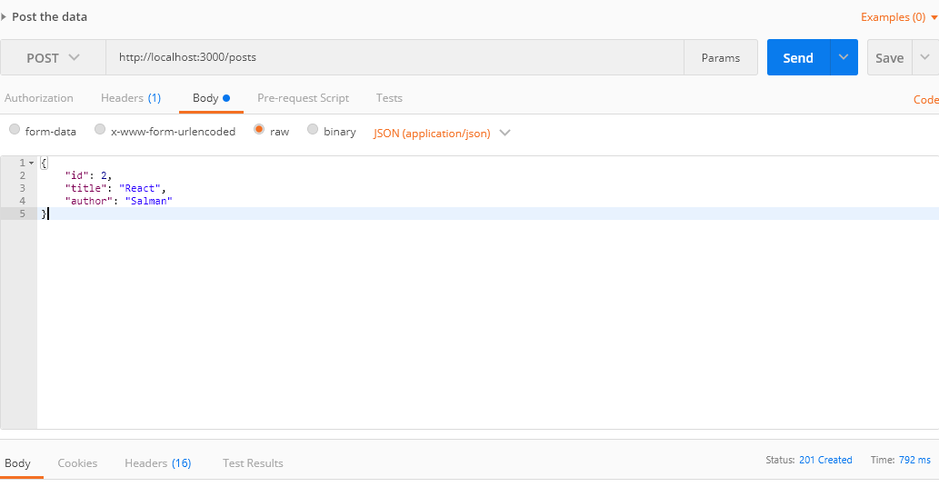
Post method

Slide 3
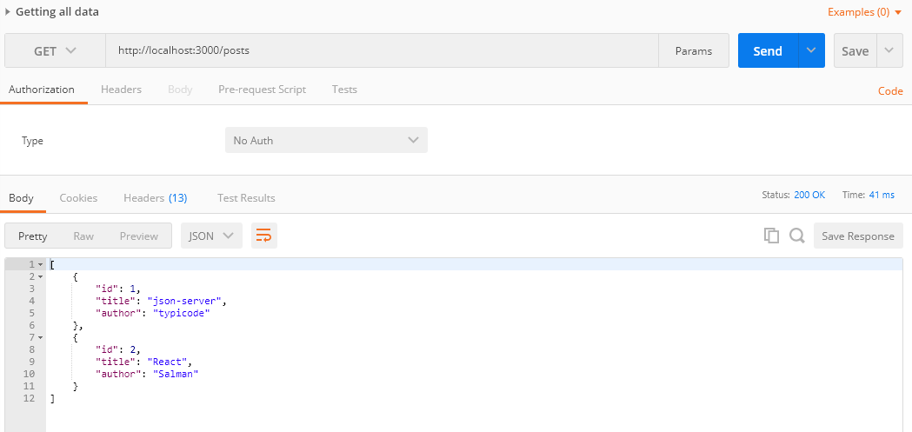
Get method – all data

Slide 4
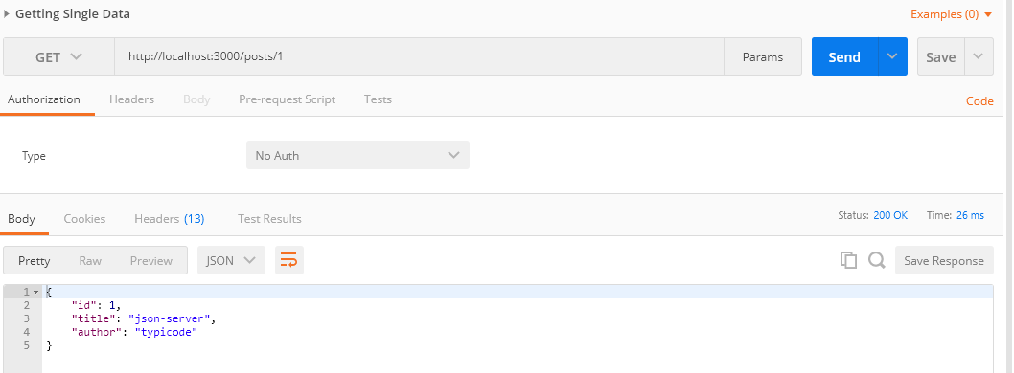
Get method – with single data

Slide 5
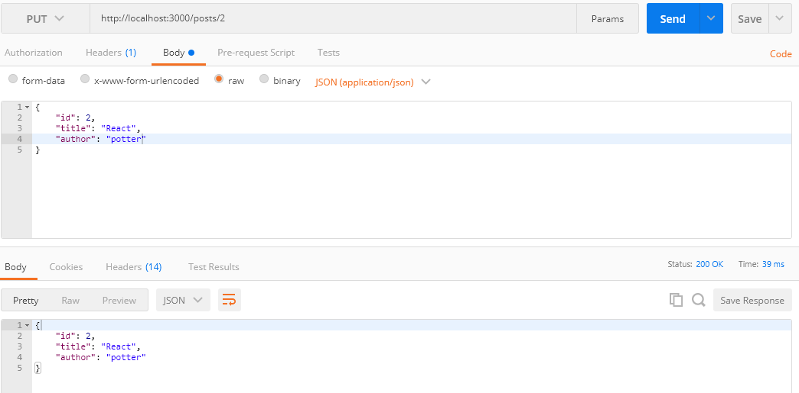
Put method

Slide 6
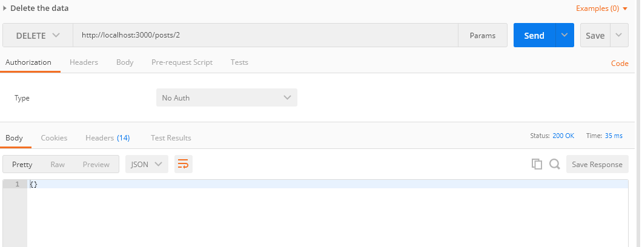
Delete method

Slide 7
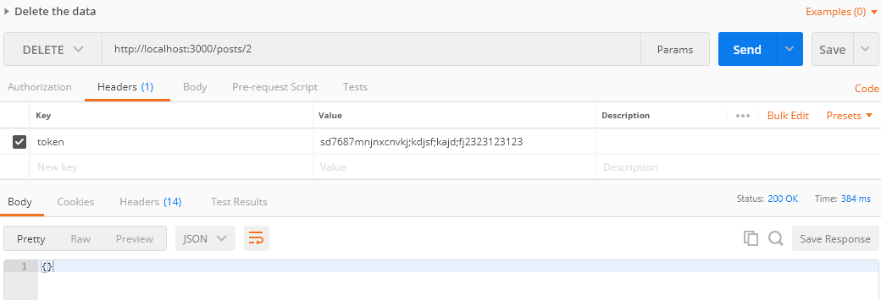
Passing data in header

